Slide 1
GLOBAL SUPERSTORE
I worked on the data from the GLOBAL SALE reveals comprehensive insights into the sales performance of various product categories over time.
I derived insights from the sales trend over time, top-selling products of all categories, the profitability of each category, the correlation between the discount and the profit, the shipping costs by region and the sales by customer segment.
The insights generated informed advise the global superstore can use in optimizing their profits by improving logistics to certain areas and seasonal spikes in sales.

Slide 2
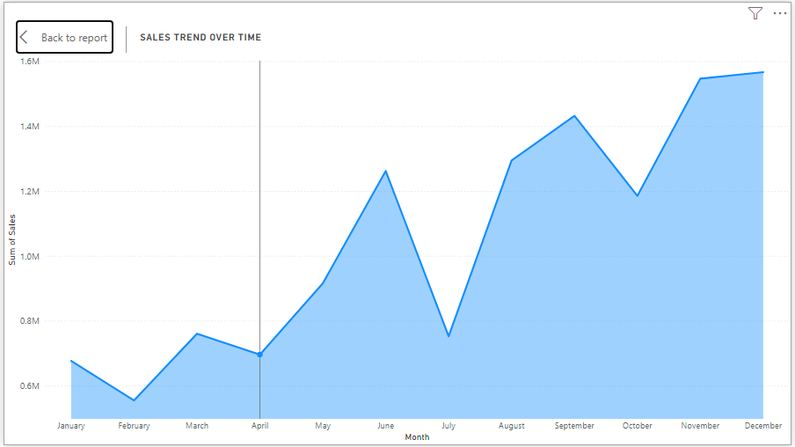
SALES TREND OVER TIME
The data from the GLOBAL SALE reveals comprehensive insights into the sales performance of various product categories over time. Monthly sales trends indicate that specific months experience higher sales suggesting seasonality that could be leveraged for targeted marketing campaigns. ﻿At 1,566,662.45, December had the highest Sum of Sales and was 182.46% higher than February, which had the lowest Sum of Sales at 554,649.89.﻿﻿﻿﻿ ﻿﻿December accounted for 12.39% of Sum of Sales.﻿﻿ ﻿﻿

Slide 3
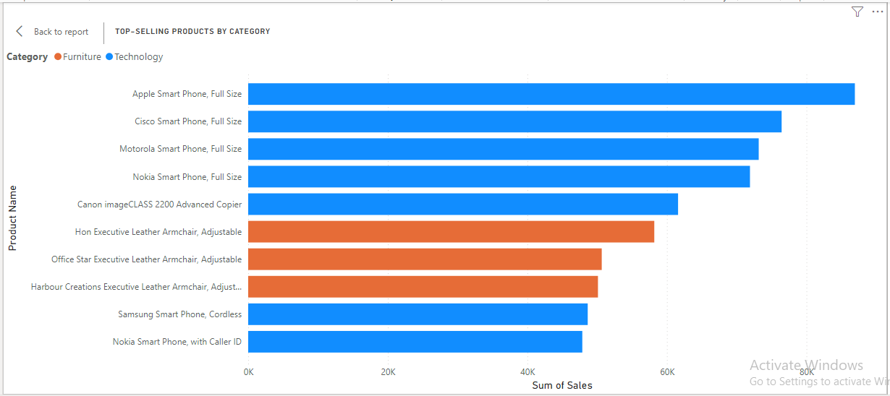
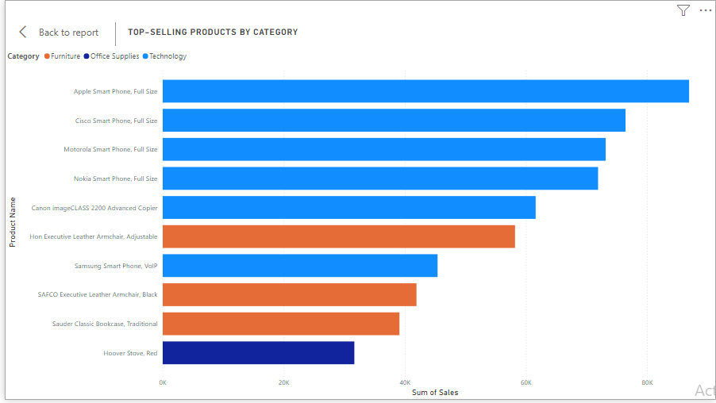
TOP-SELLING PRODUCTS BY CATEGORY
The identification of top-selling products, particularly in the Furniture and Technology categories, highlights opportunities for increased inventory and promotional focus on these items to drive revenue. The absence of Office Supplies is also a note to improve marketing strategies in that category.

Slide 4
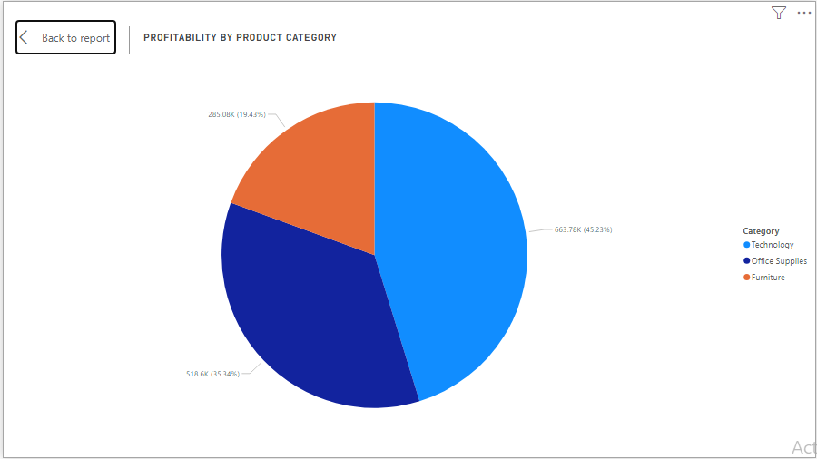
PROFITABILITY BY PROFIT CATEGORY
Profitability analysis shows differing margins across product categories, emphasizing the need for strategic adjustments to maximize profits. High-margin categories should be prioritized in marketing efforts, while underperforming products may require evaluation for potential discontinuation or repositioning in the market.

Slide 5
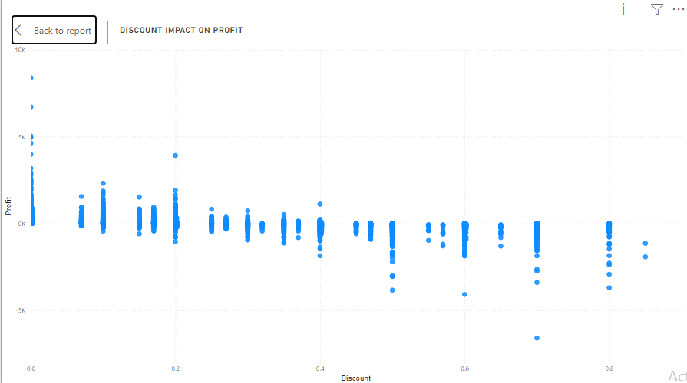
DISCOUNT IMPACT ON PROFIT
There is no correlation between the discount and the profit, as the data points are scattered impact of discounts on profit margins indicates the necessity for careful management of promotional strategies to optimize revenue without eroding profitability.

Slide 6
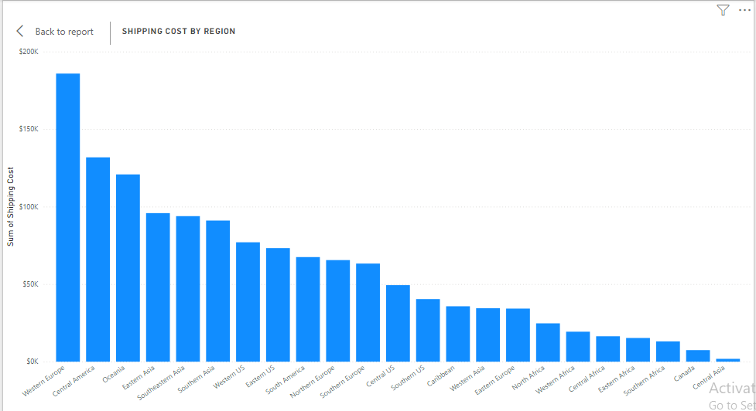
SHIPPING COSTS BY REGION
Shipping costs, particularly in regions like Canada and the Central Asia, point to areas where logistics efficiencies can be improved, potentially reducing overhead and enhancing profit margins.

Slide 7
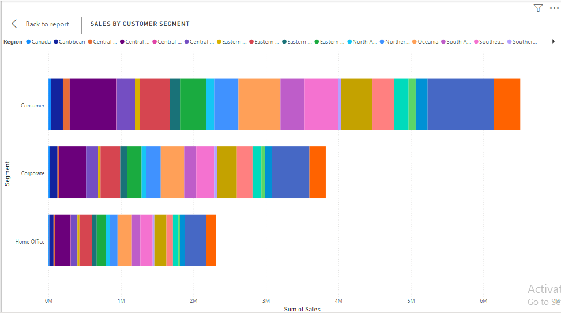
SALES BY CUSTOMER SEGMENT
Customer segmentation data indicates varying sales performance across different customer types, suggesting that tailored marketing strategies could significantly boost engagement and conversion rates. Implementing loyalty programs for high-value segments could foster repeat business and increase overall profitability. Geographic analysis reveals potential for market expansion in regions with lower sales performance, where focused marketing efforts and localized campaigns could capture additional market share. Furthermore, prioritizing critical orders and optimizing inventory management based on sales trends can improve operational efficiency, reduce costs, and enhance customer satisfaction.

Slide 8
THANK YOU

